Slide 1
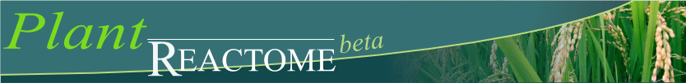
Plant Reactome
Palitha Dharmawardhana & Justin Preece
Oregon State University

Slide 2
Outline
Pathway databases
What is Reactome?
Reactome Data model
Plant Reactome with Rice as the reference species
Exploring rice pathways: Few examples
Plant Reactome development
Website Navigation and demonstration
Upcoming developments

Slide 3
Pathway databases and analysis
A more efficient and intuitive way of visualizing biological data
Computer readable pathways facilitate
Updating and curation
Visualization of high-throughput data types
Identifying patterns and trends in data
Functional annotation of genes
Gene list data reduction

Slide 4
What is Reactome
A curated open source and open access pathway database (www.reactome.org)
>1400 pathways on human metabolism, signaling, and gene regulation etc.
Human is the Reference species with extension to other species based on gene orthology and inferred reactions

Slide 5
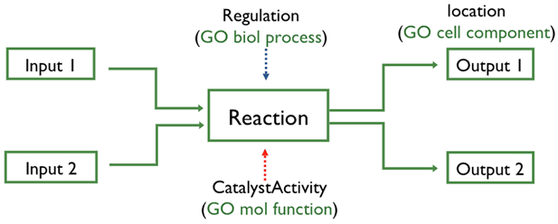
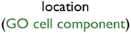
Reactome data model
Depicts biological processes as a set of connected reactions and events
It can represent many events and states in biological processes
In addition to classical biochemical reactions, changes in state, such as binding, activation, translocation and degradation can be represented
Reactions are connected to form pathways

Slide 6
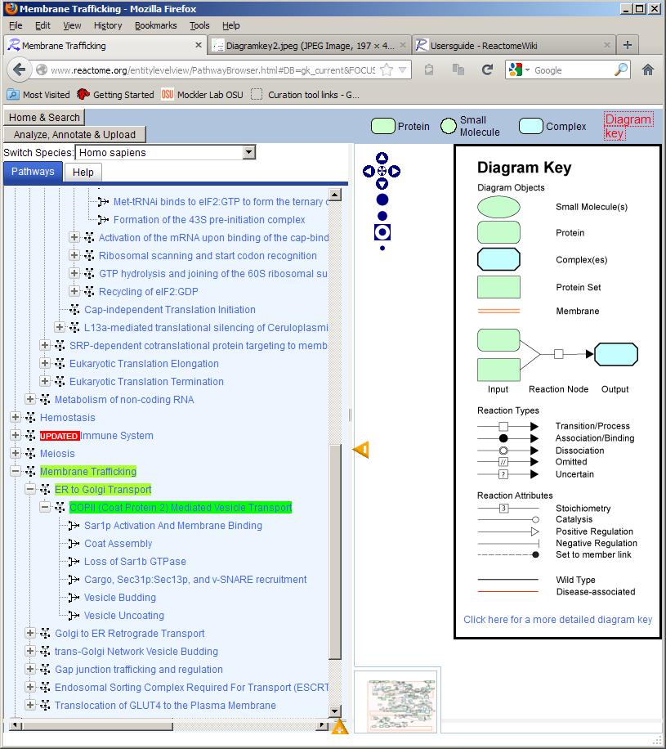
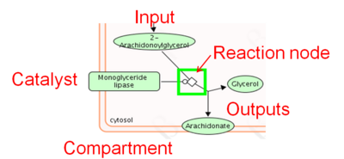
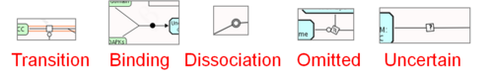
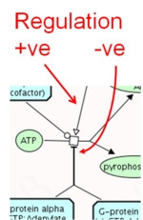
Interpreting pathway diagrams:

Slide 7
Plant Reactome

Slide 8
Plant Reactome pathway data sources in beta release
Rice is represented as the reference species
Metabolic pathways from Gramene RiceCyc v3.1
Orthology based inferred pathway projections from Reactome (H. sapiens)

Slide 9
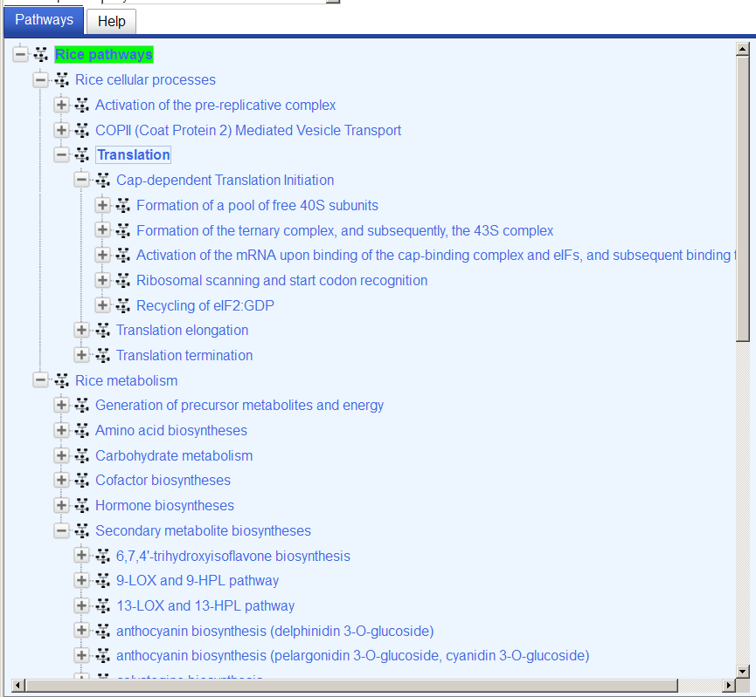
Rice pathway types & hierarchy:

Slide 10
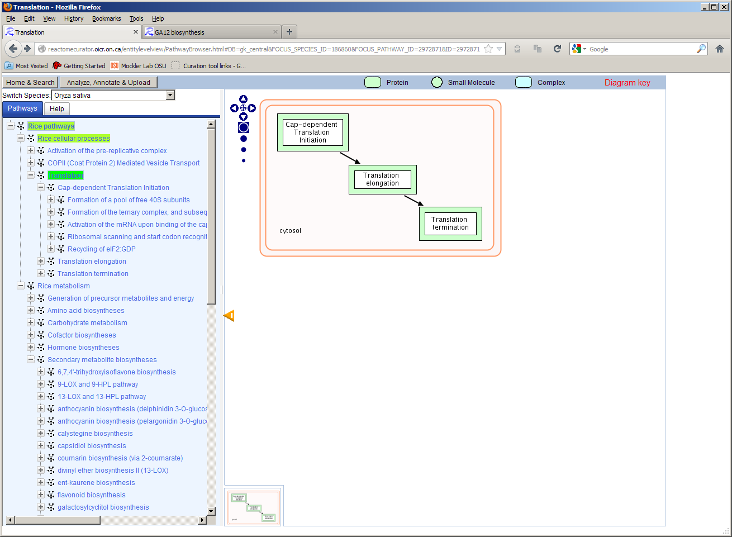
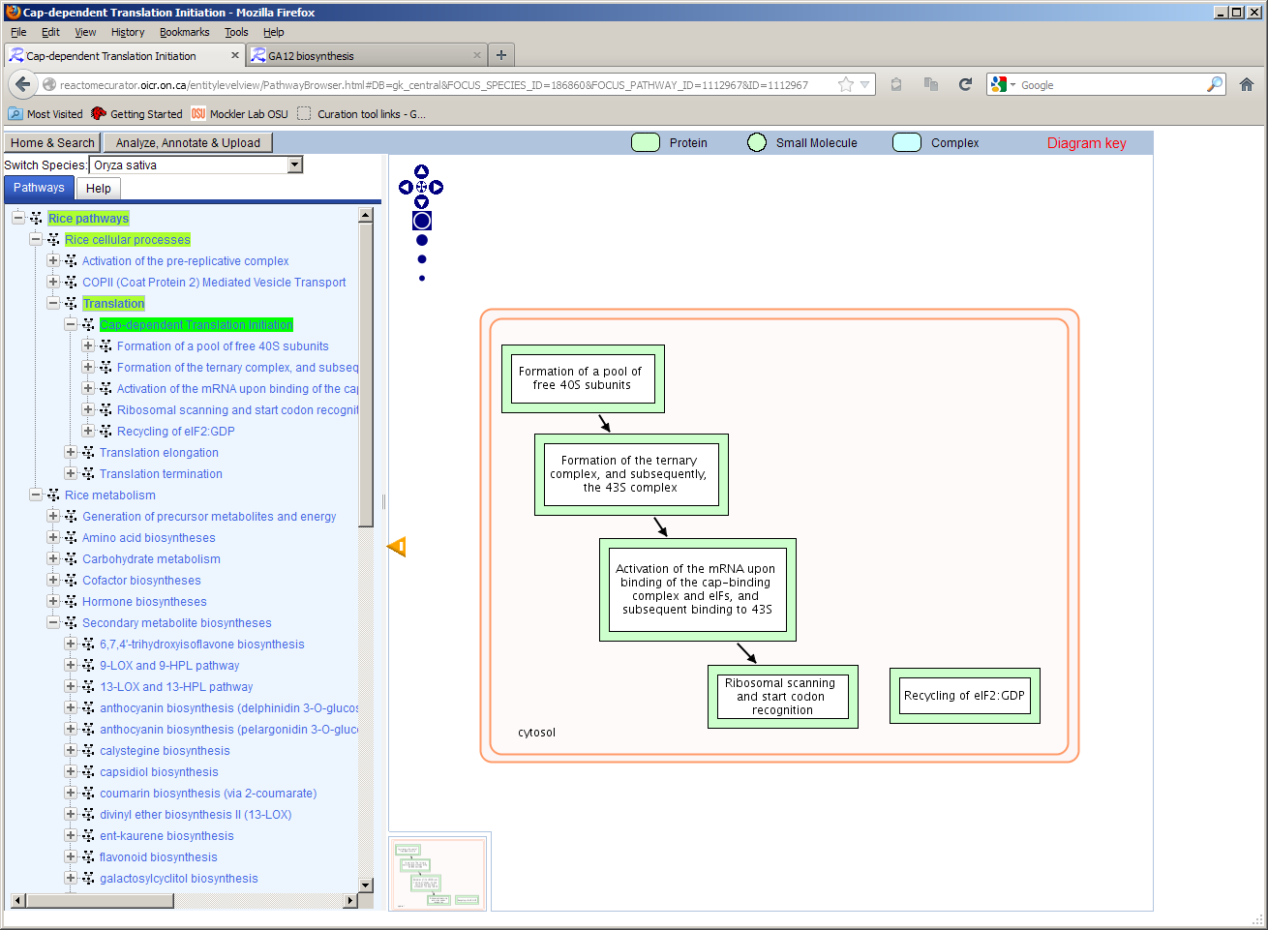
Pathway hierarchy example Translation: Cap-dependent translation initiation

Slide 11
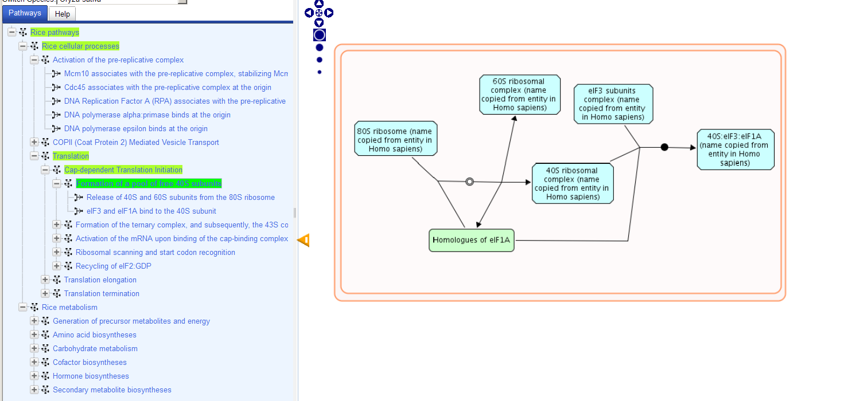
Cap-dependent translation initiation example cont.
Two Reactions:
Dissociation: 80S monosomes dissociate into 40S and 60S ribosomal subunits. eIF1A promotes this dissociation
Association: eIF3 and eIF1A bind to the 40S ribosomal subunit

Slide 12
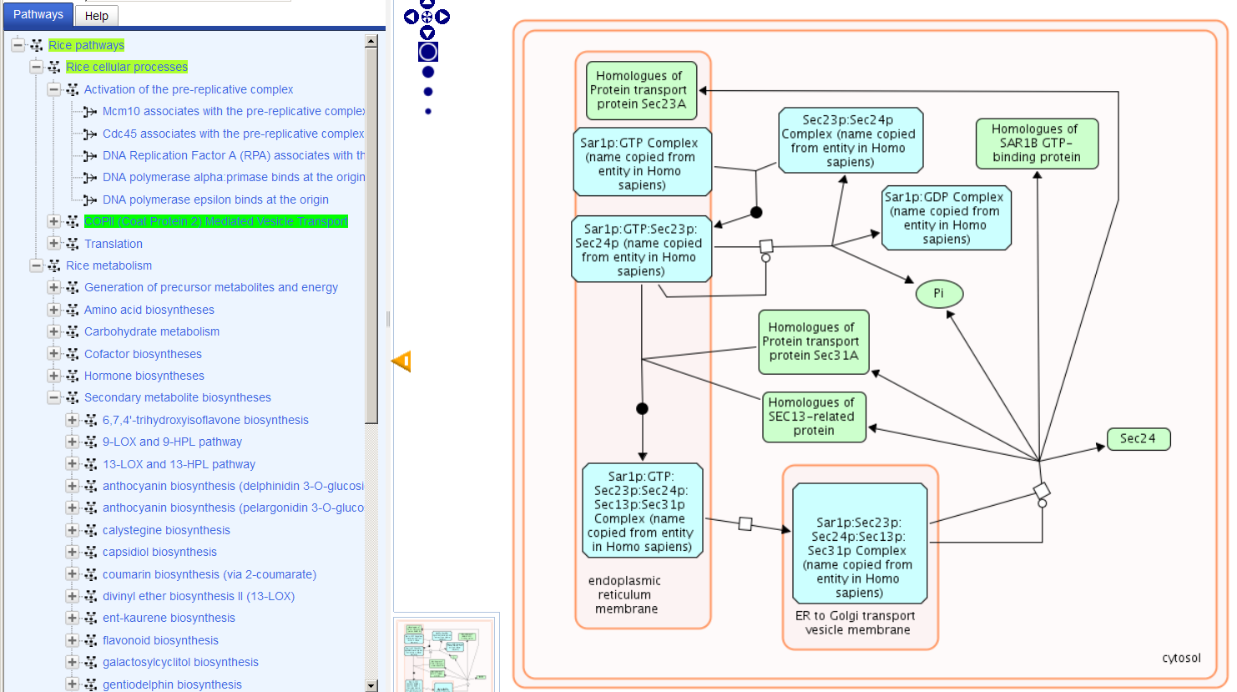
Cellular locations/Compartments of reactions and pathways: COPII (Coat Protein 2) Mediated Vesicle Transport
COPII components traffic cargo from the endoplasmic reticulum to the Golgi apparatus

Slide 13
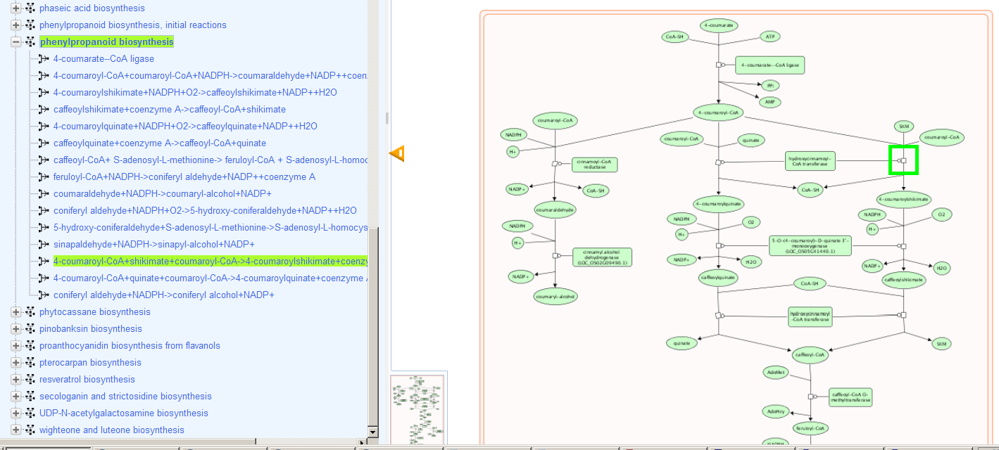
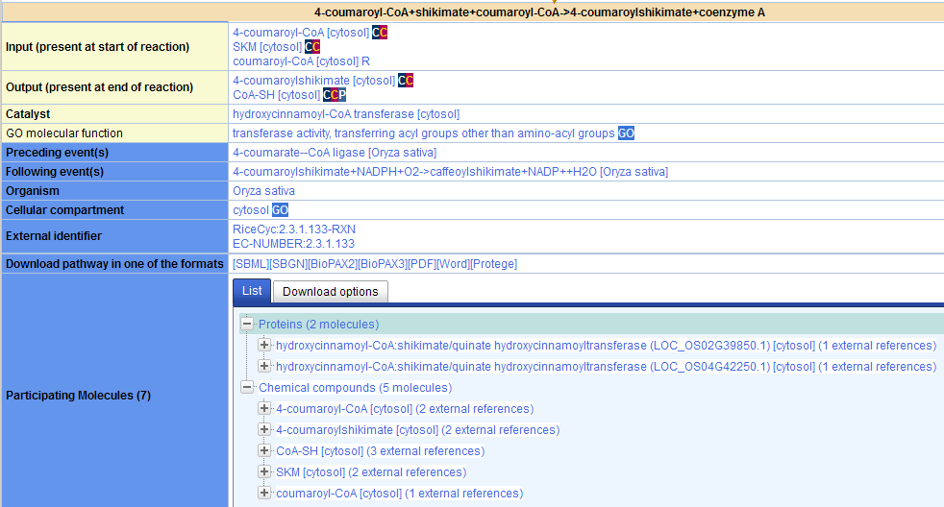
Reaction details: Phenylpropanoid biosynthesis

Slide 14
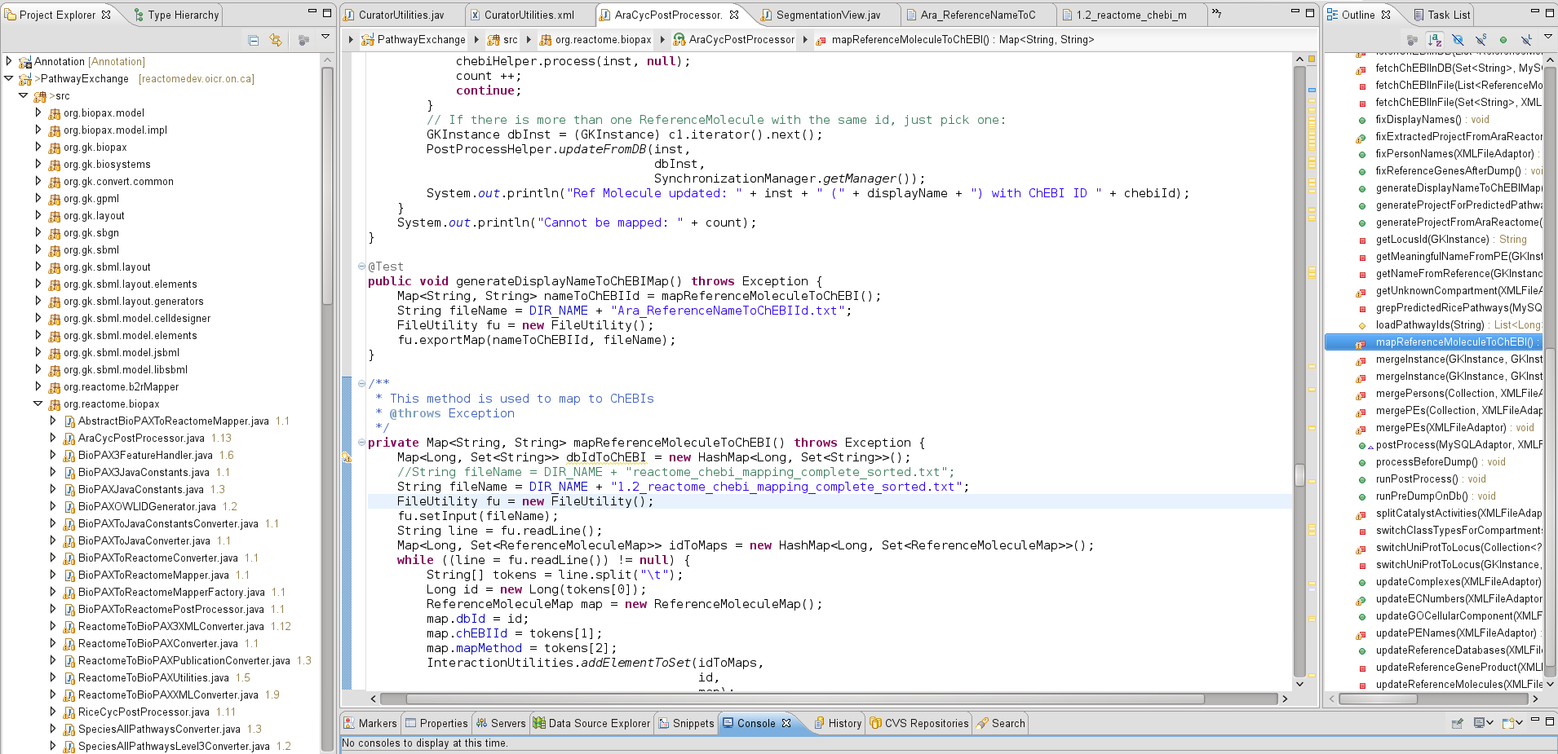
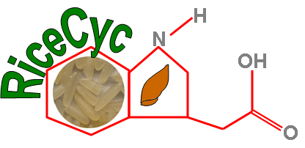
Plant Reactome development
Data sources
RiceCyc 3.1
Rice projections from Reactome (H. sapiens)
“Cyc” Conversion process
Exported rice data from RiceCyc 3.1 in BioPAX format
Ran “Pathway Exchange” data conversion utility (Java)
Performed additional mappings and refinements
Updated ChEBI references for Reference Molecules
UniProt review of the O. s. japonica proteome
Pathway layout illustration in Reactome Curator Tool

Slide 15
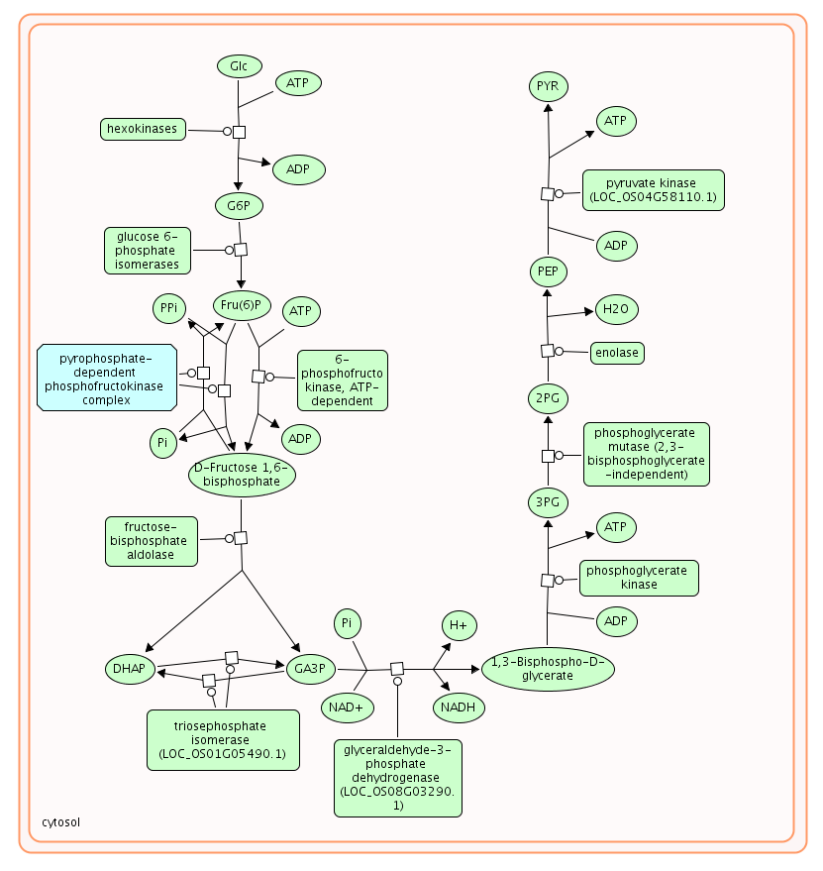
Demonstration: Exploring rice metabolism in the Plant Reactome
Site tour

Slide 16
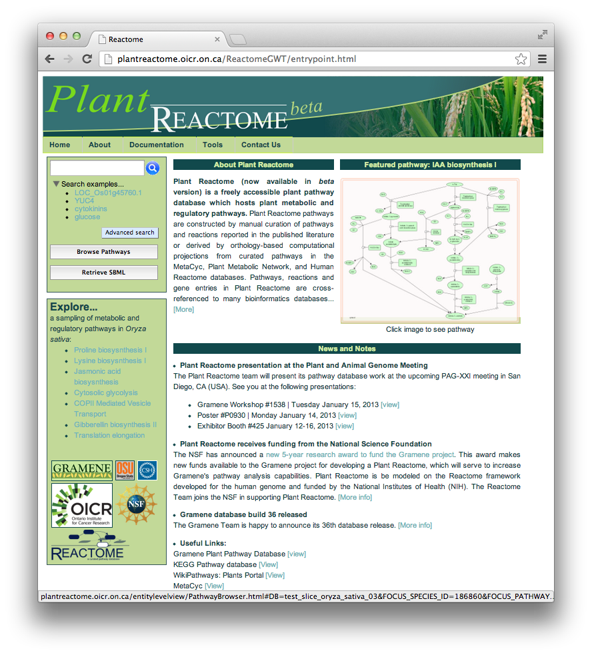
Plant Reactome Front Page
Menu
Pathway Search Box
Featured pathway
More pathways of interest

Slide 17
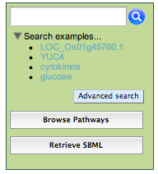
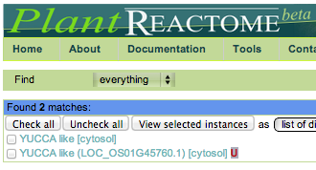
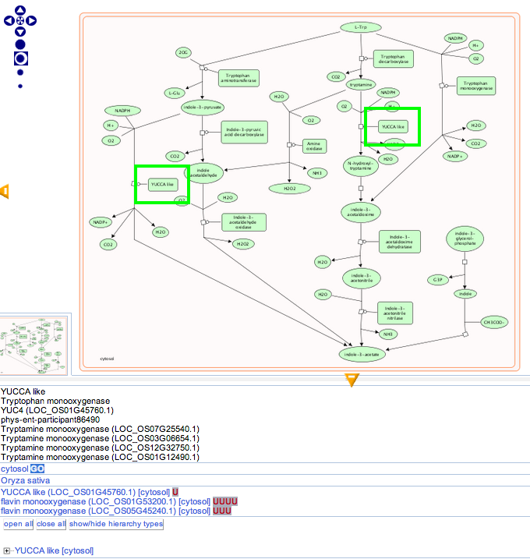
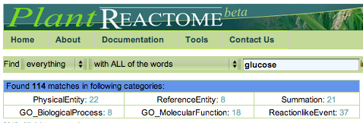
Search for pathways, reactions, and genes

Slide 18
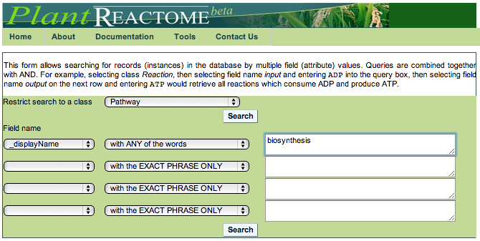
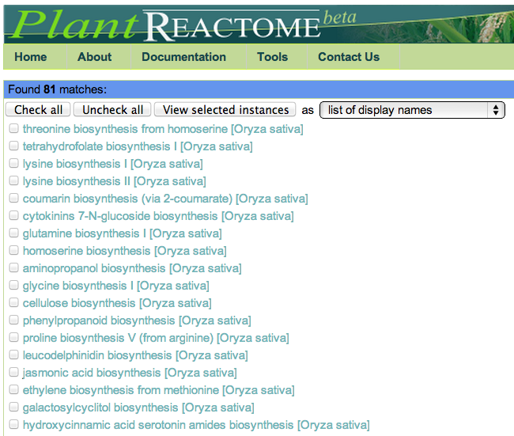
Advanced Search

Slide 19
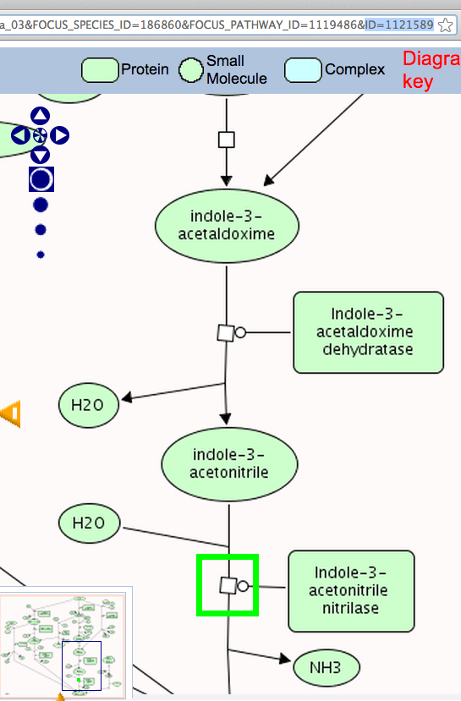
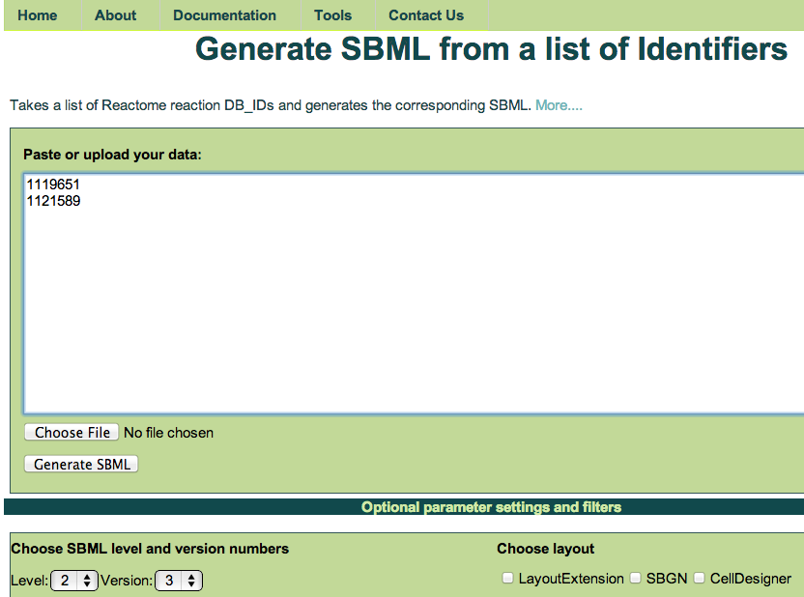
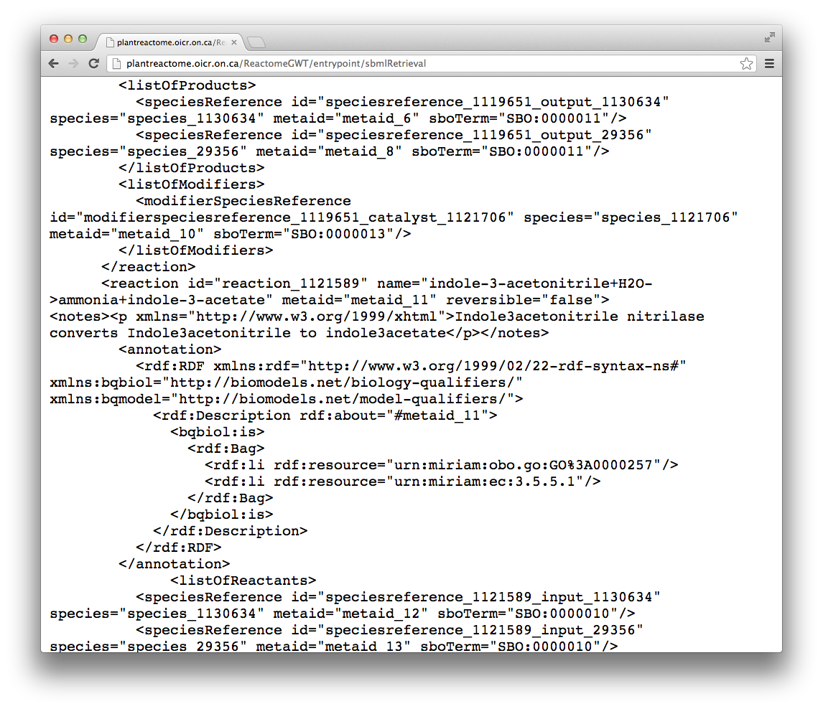
Generate SBML

Slide 20
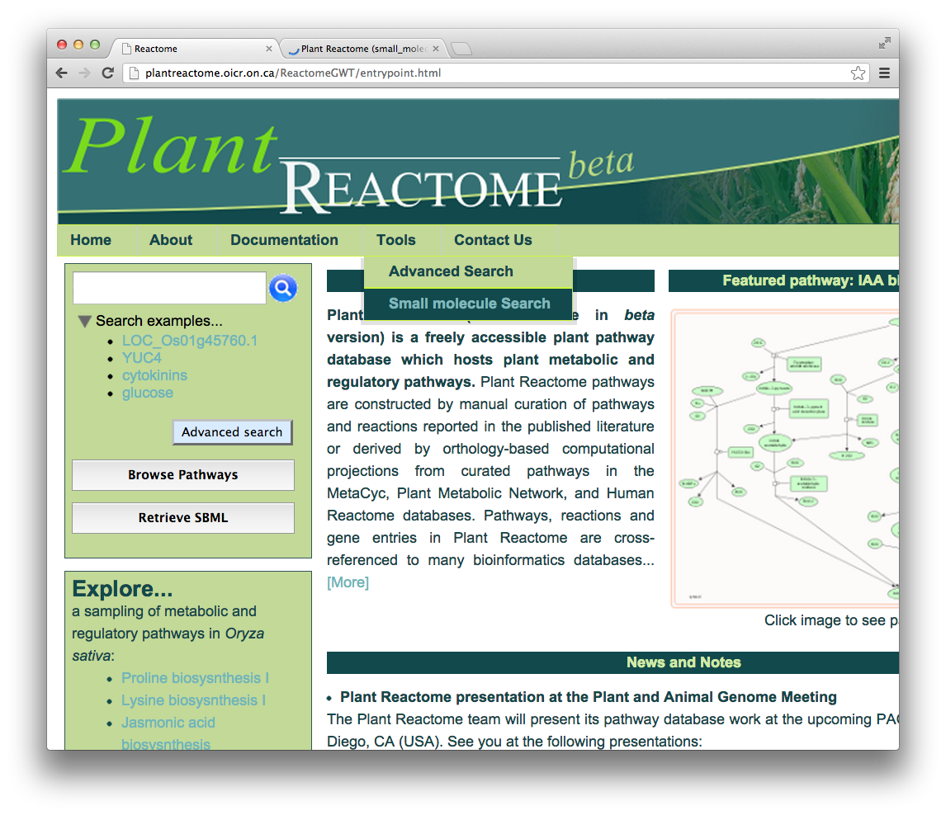
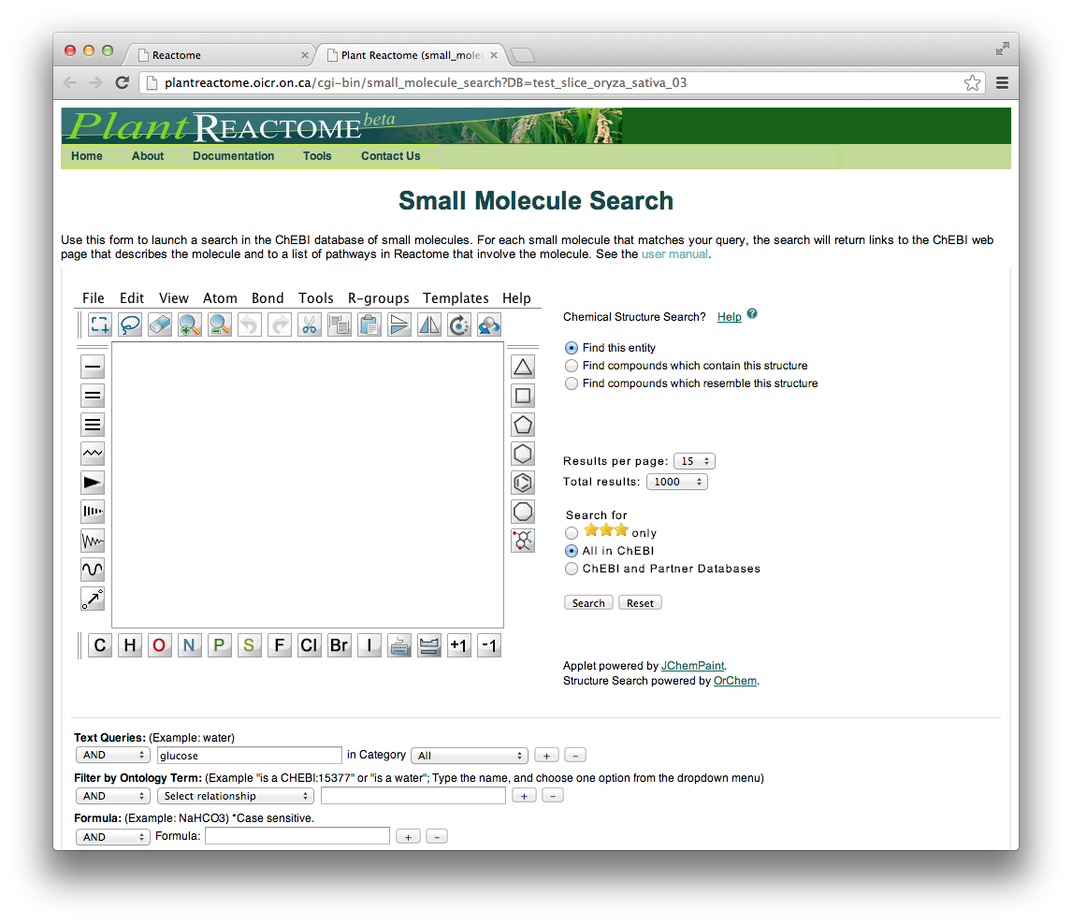
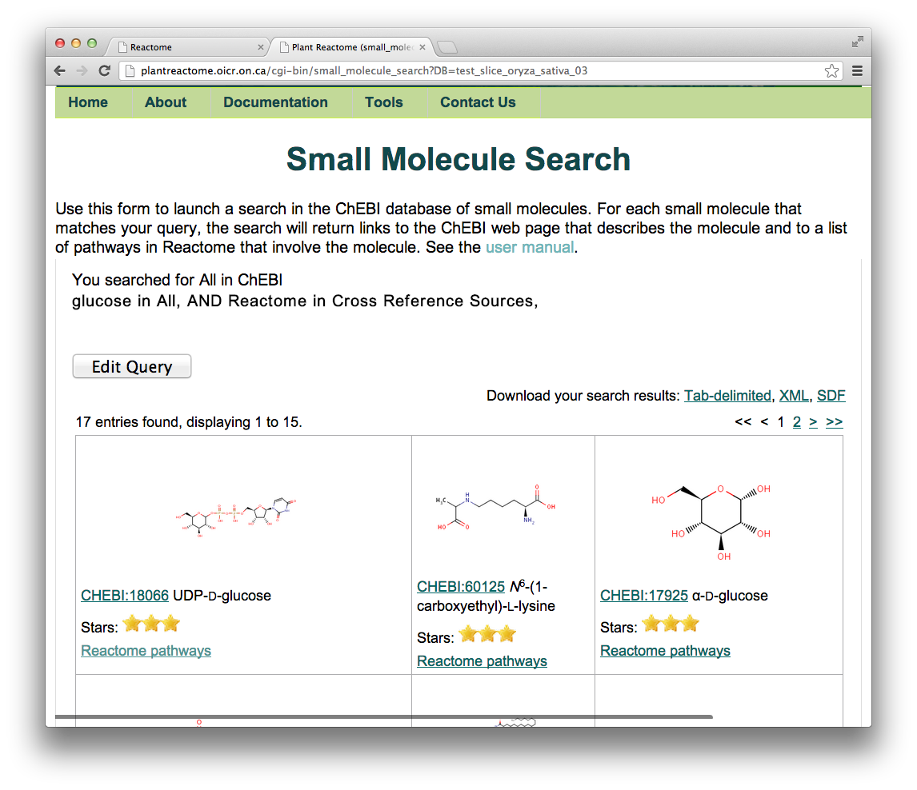
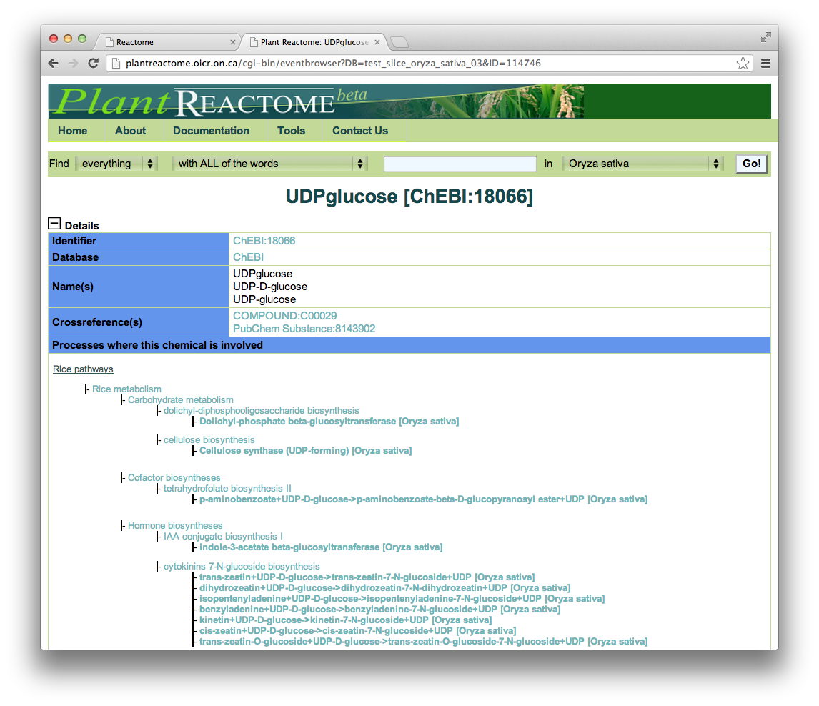
Small Molecule Search

Slide 21
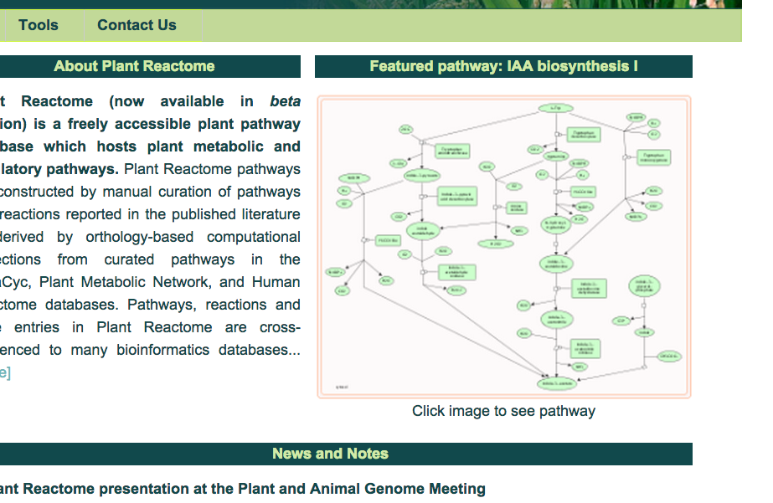
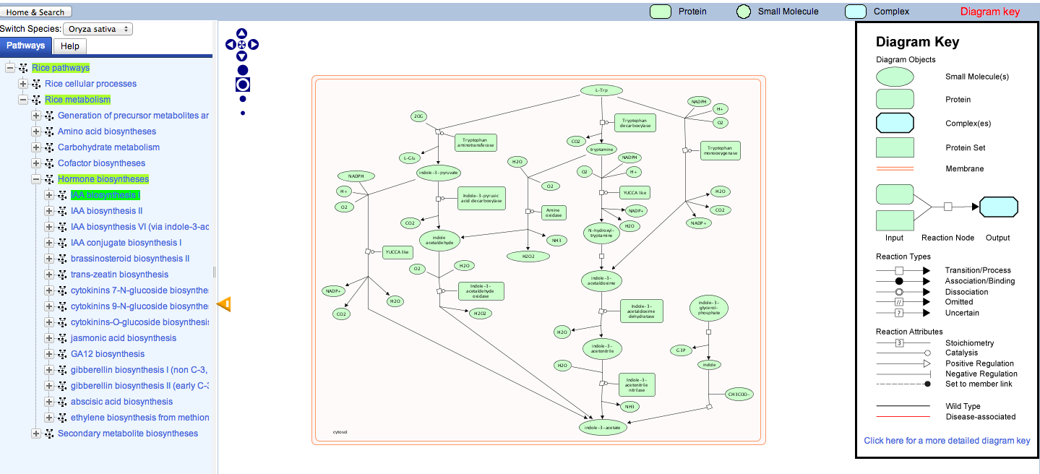
Featured Pathway

Slide 22
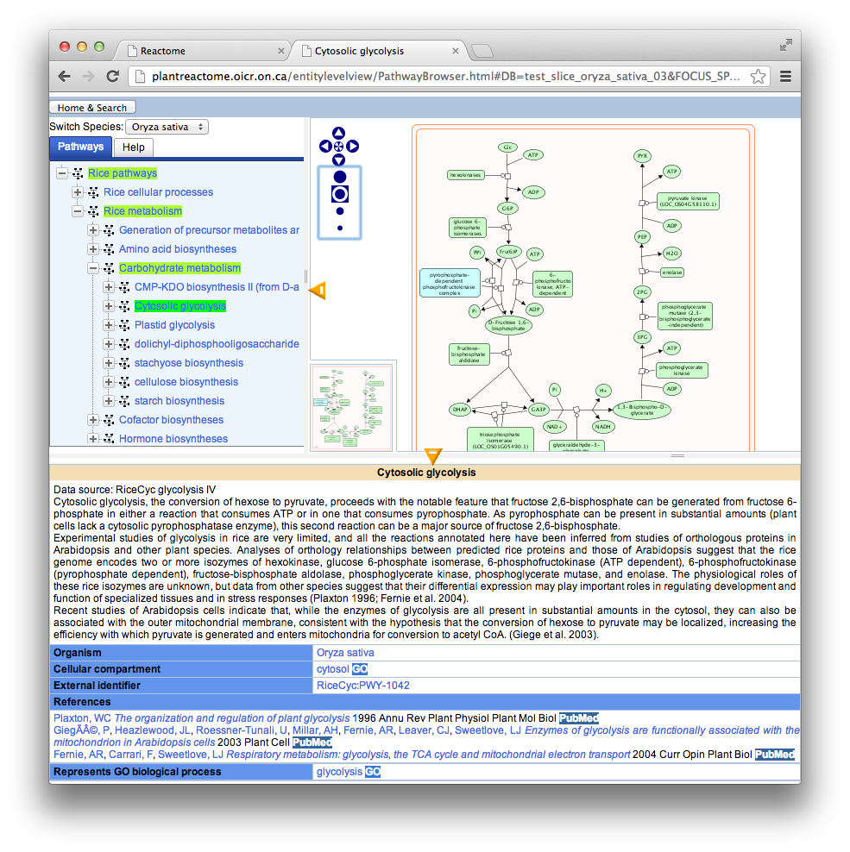
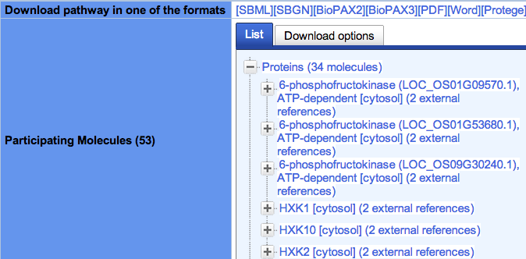
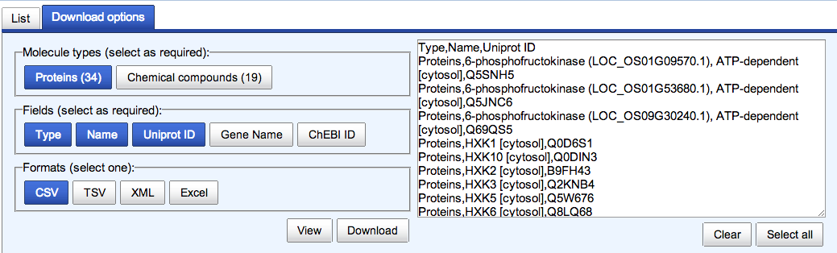
Cytosolic glycolysis
Pathway details on bottom panel:
Reference info
Compartment
Pathway download
Participating molecules

Slide 23
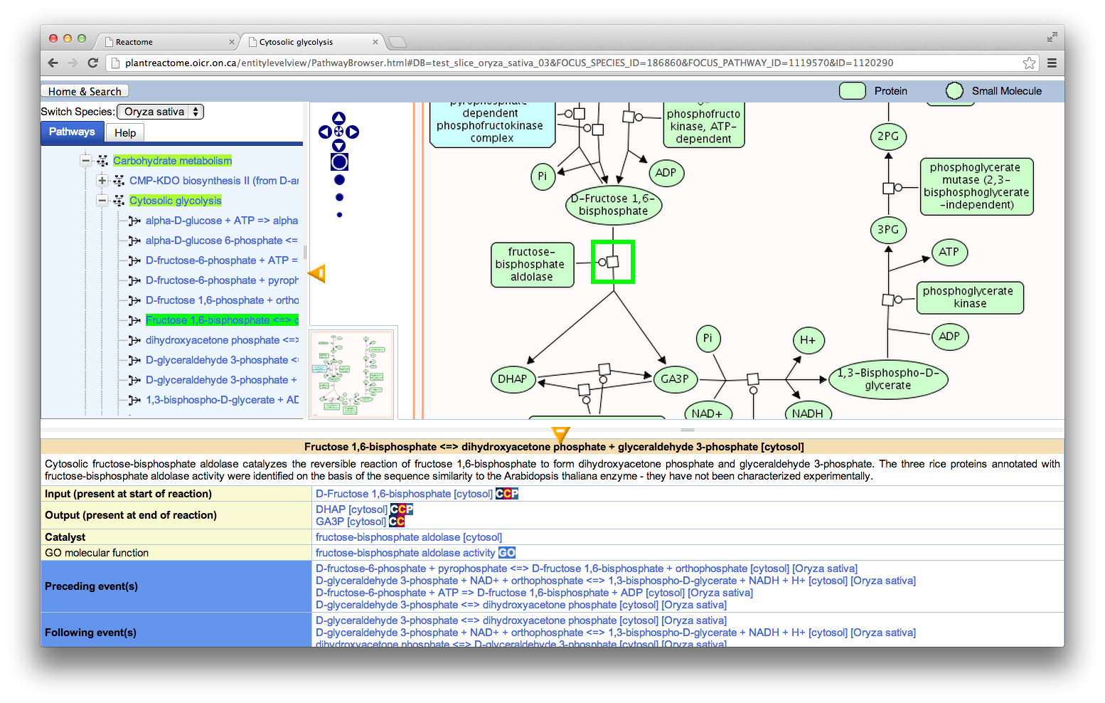
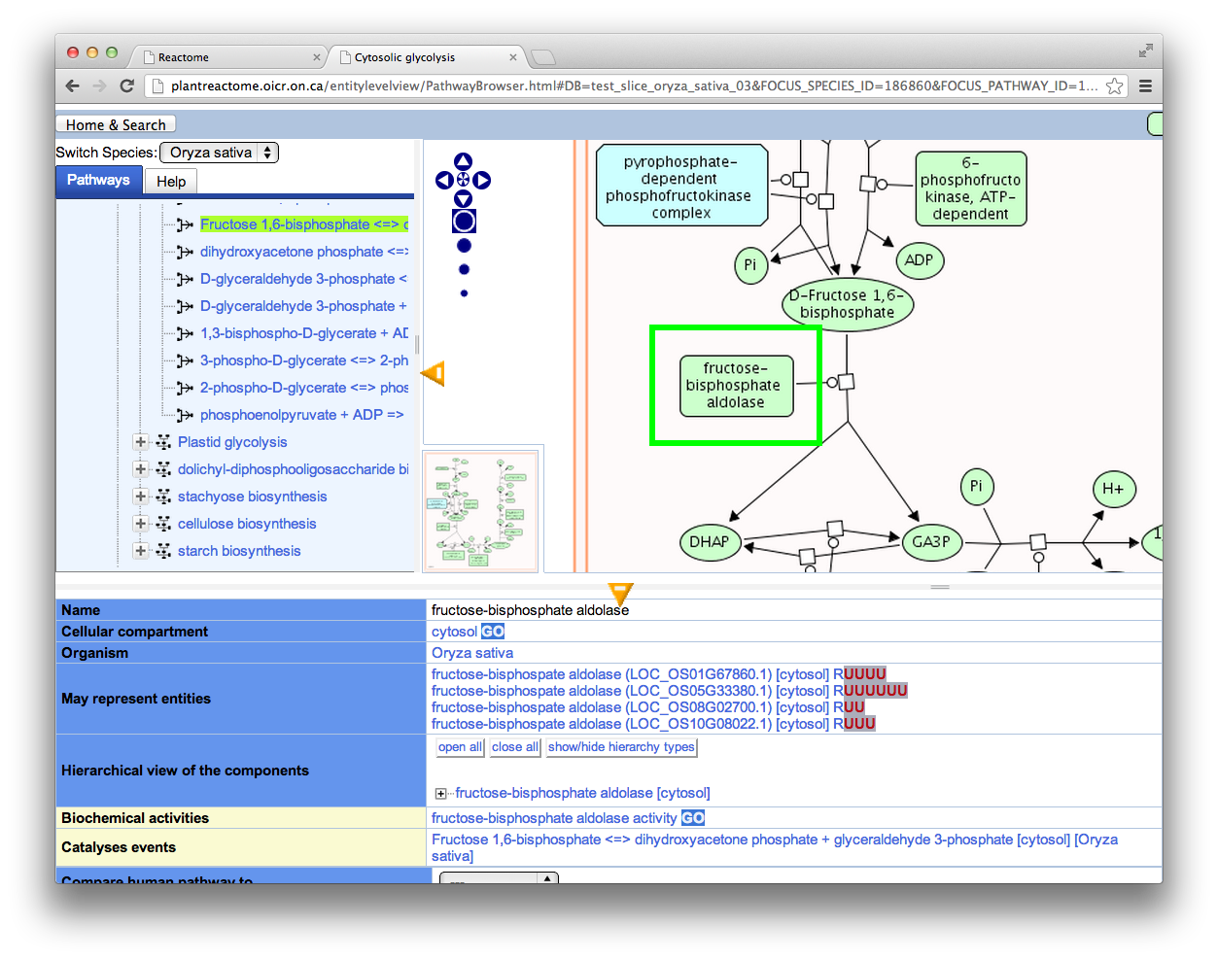
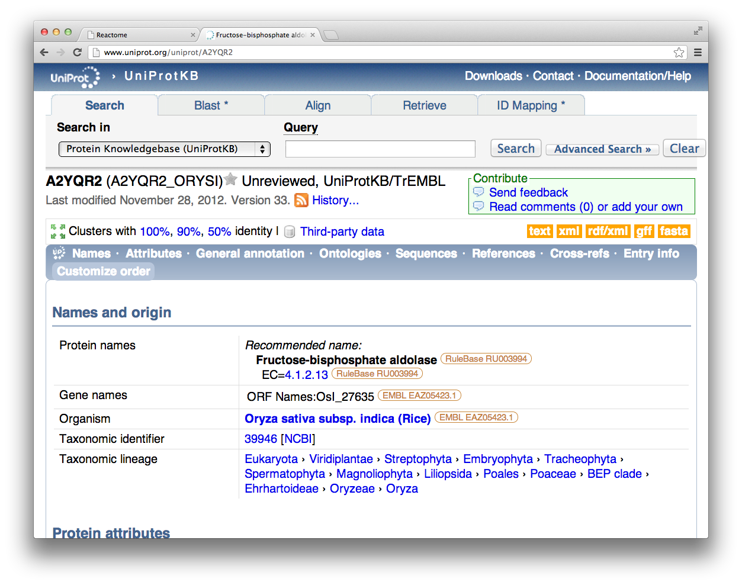
Reaction-level Data

Slide 24
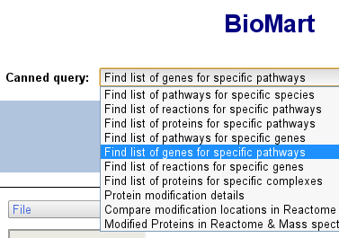
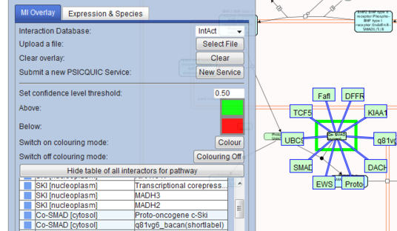
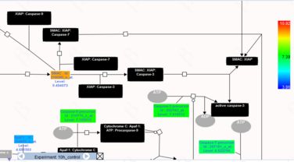
Upcoming developments
Include additional metabolic and regulatory rice pathways
Enable more Reactome analysis tools:
Gene expression overlay
Interaction analysis
Enrichment analysis
Reactome BioMart
Species comparison
Bring Arabidopsis into the Plant Reactome as a reference species
Update the existing AraCyc Reactome data conversion
Perform regulatory pathway projections from Reactome (H. sapiens)
Run Ensembl Compara projections to other species, including maize

Slide 25
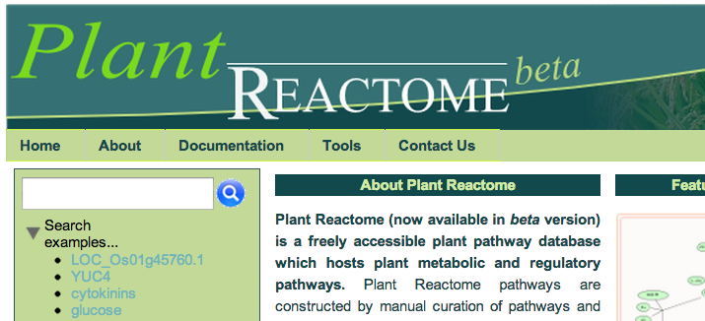
Questions, comments, suggestions, and bug reports
reactome-curator@gramene.org

Slide 26






Acknowledgements
Oregon State University
Pankaj Jaiswal (PI)
Palitha Dharmawardhana (Curation and coordination)
Sushma Naithani (Curation and outreach)
Vindhya Amarasinghe (Curation)
Justin Preece (Software development and database management)
Dylan Beorchia (Undergraduate student curator)
Kindra Amoss (Undergraduate student curator)
Cold Spring Harbor Laboratory
Doreen Ware (PI)
Marcela Monaco (Gramene coordination and outreach)
Collaborators
Reactome Project
Ontario Institute for Cancer Research
Lincoln Stein (Reactome PI)
Guanming Wu (Software and data management)
Robin Haw (Web servers and outreach)
NYU
Peter D'Eustachio (Curation mentor and outreach)
European Bioinformatics Institute
Henning Hermjakob (Reactome and IntAct PI)
David Croft (Software)
Species-wide data
Maize
Carolyn Lawrence (MaizeGDB)
Andrew Hanson (Vitamin-B pathways)
Arabidopsis
Nick Provart (BAR PI)
Hardeep Nahal (Curation)

